Slide 1

Web Server
Huang Hao, Zhou Yitong, Meng Yu, Chen Zijie, Wen Tianshu
2024.11.8

Slide 2
CONTENTS
Introduction of web server
01 Introduction
Divide of tasks
02 client
CONTENTS
03 server
04 Test
Version control
05 Conclusion
Summarize functional implementations

Slide 3
01
PART
Introduction

Slide 4






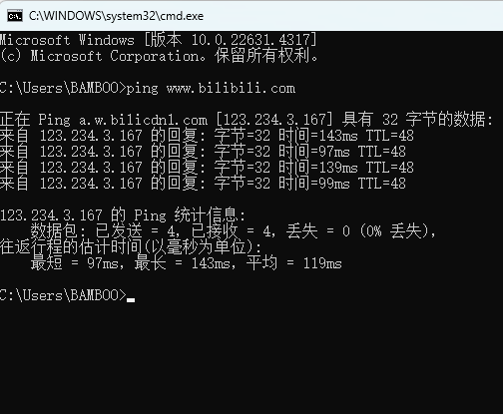
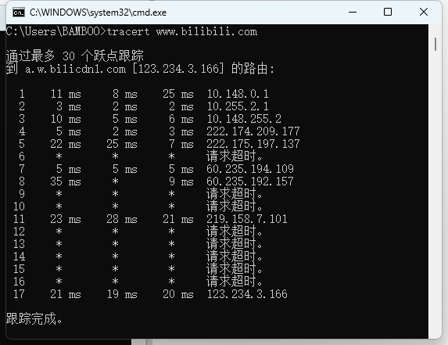
Prepare
client
server
test
conclusion
Traceroute VS Ping
Ping
Traceroute
Send packet
+
Receive packet
Whether the packet can reach the destination
Where is the packet going

Slide 5
Prepare
client
server
test
conclusion
Division of tasks
Huang Hao
Getting through the code framework
UI design
safety config design
Windows testing
Wen Tianshu
server design
log safety
rate control
Zhou Yitong
Beautify output
Task framework design
test_client design
Chen Zijie(presentor)
concurrent control
muti-file construction
test_client design
Meng Yu
client design
Functional testing
test_client design

Slide 6
02
PART
client

Slide 7


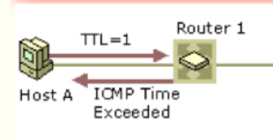
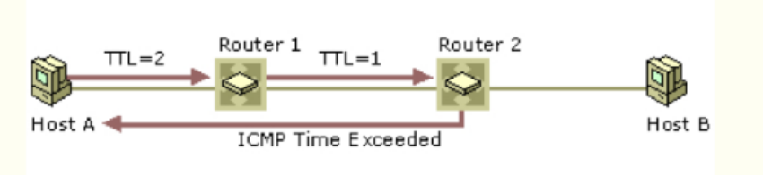
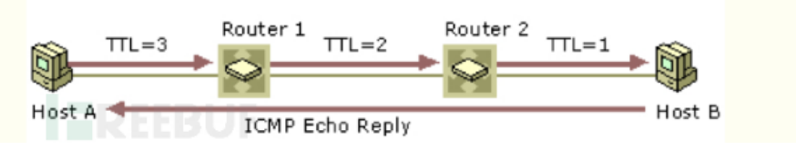
Prepare
client
server
test
conclusion
Traceroute Process
set socket
Tracert multiple TTL
extra
send packet
ICMP
------
create packet
Tracert
---
UDP
Animate (Real-time plotting)
functions
receive packet
---
Identity Error / Hostname+addr
(icmp_type)
TTL=0
Send ICMP:
Send UDP:

Slide 8
03
PART
server

Slide 9

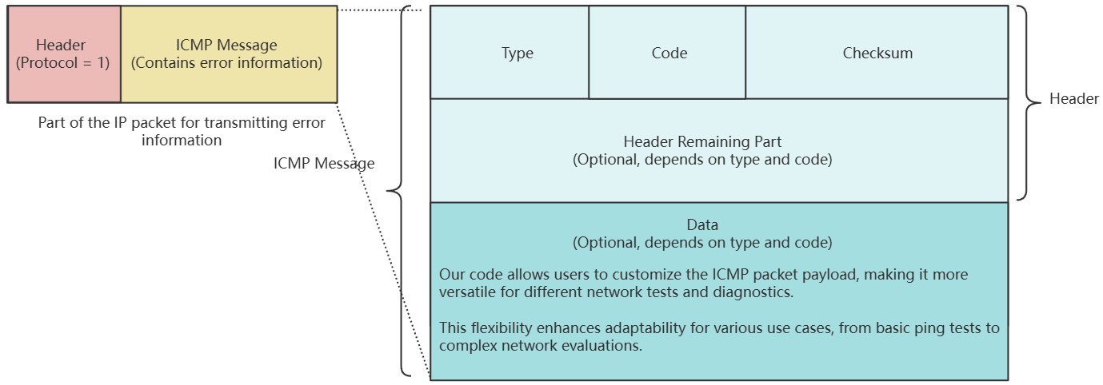



Prepare
client
server
test
conclusion
UDP Packet Creation Explanation
ICMP Packet Composition
1. The packet consists of two main parts: the header and the data.
2. The header includes essential control information like Type, Code, Checksum, Packet ID, and Sequence Number.
3. The data section contains user-defined data, often used for diagnostic purposes like timestamps or padding.
bbHHh Explanation
Header & Data
b: 1 byte for the Type field (e.g., Echo Request or Echo Reply).
b: 1 byte for the Code field (specifies the subtype of the ICMP message).
H: 2 bytes for the Checksum (used for error checking).
H: 2 bytes for the Packet ID (to match requests with replies).
h: 2 bytes for the Sequence Number (helps track packet order).
1. The header stores the control and identification information required for ICMP communication (Type, Code, Checksum, Packet ID, Sequence Number).
2. The data section holds additional information, such as timestamps or any other diagnostic data needed for the echo request and reply process.

Slide 10
Prepare
client
server
test
conclusion
UDP Packet Creation Explanation
ICMP Packet Composition
1. The packet consists of two main parts: the header and the data.
2. The header includes essential control information like Type, Code, Checksum, Packet ID, and Sequence Number.
3. The data section contains user-defined data, often used for diagnostic purposes like timestamps or padding.
bbHHh Explanation
Header & Data
b: 1 byte for the Type field (e.g., Echo Request or Echo Reply).
b: 1 byte for the Code field (specifies the subtype of the ICMP message).
H: 2 bytes for the Checksum (used for error checking).
H: 2 bytes for the Packet ID (to match requests with replies).
h: 2 bytes for the Sequence Number (helps track packet order).
1. The header stores the control and identification information required for ICMP communication (Type, Code, Checksum, Packet ID, Sequence Number).
2. The data section holds additional information, such as timestamps or any other diagnostic data needed for the echo request and reply process.

Slide 11

Prepare
client
server
test
conclusion
UDP Packet Creation Explanation
ICMP Packet Composition
1. The packet consists of two main parts: the header and the data.
2. The header includes essential control information like Type, Code, Checksum, Packet ID, and Sequence Number.
3. The data section contains user-defined data, often used for diagnostic purposes like timestamps or padding.
bbHHh Explanation
Header & Data
b: 1 byte for the Type field (e.g., Echo Request or Echo Reply).
b: 1 byte for the Code field (specifies the subtype of the ICMP message).
H: 2 bytes for the Checksum (used for error checking).
H: 2 bytes for the Packet ID (to match requests with replies).
h: 2 bytes for the Sequence Number (helps track packet order).
1. The header stores the control and identification information required for ICMP communication (Type, Code, Checksum, Packet ID, Sequence Number).
2. The data section holds additional information, such as timestamps or any other diagnostic data needed for the echo request and reply process.

Slide 12
04
PART
Testing

Slide 13





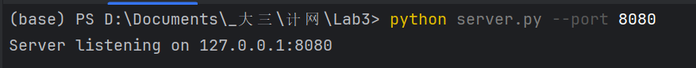
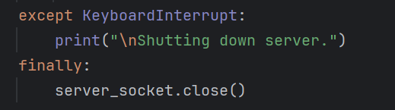
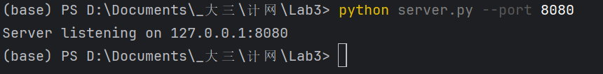
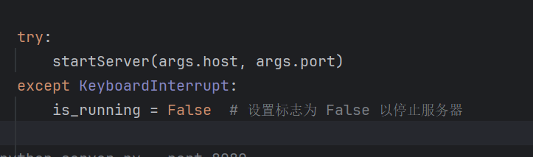
introduction
client
server
test
conclusion
Multiple problems have been solved
1. server.py can’t stop running:
Possible Solution:
Capturing Keyboard Interrupts
Using Flag Variables to Control Server Acceptance Status

Slide 14
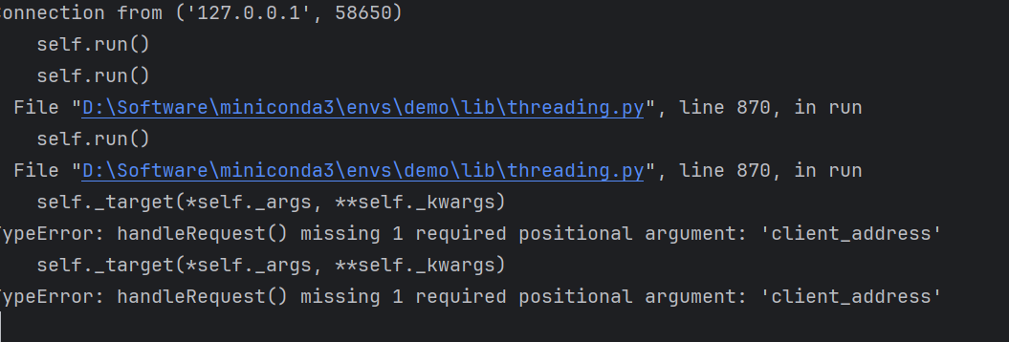
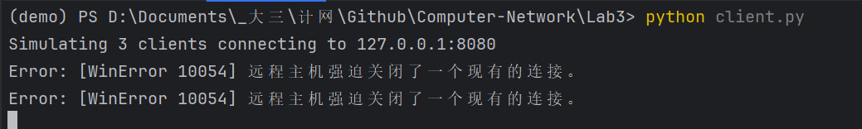
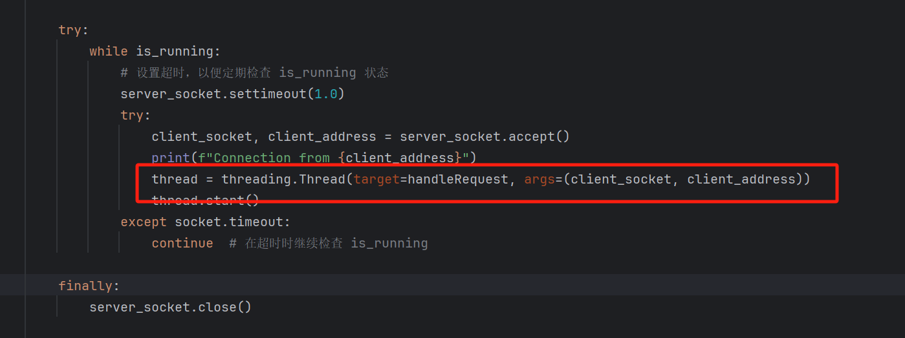
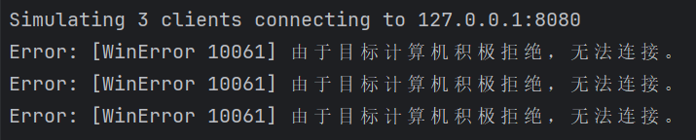
introduction
client
server
test
conclusion
Multiple problems have been solved
2. Network problem:
Should add a new parameter
Should close the proxy & check ip/port/defender

Slide 15
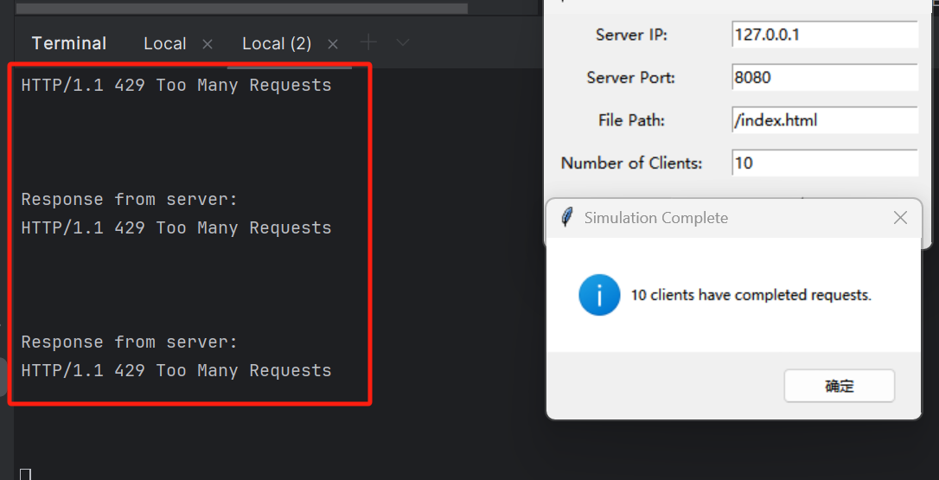
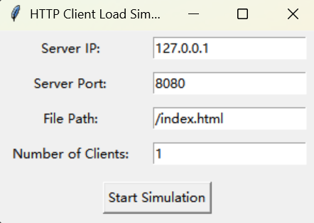
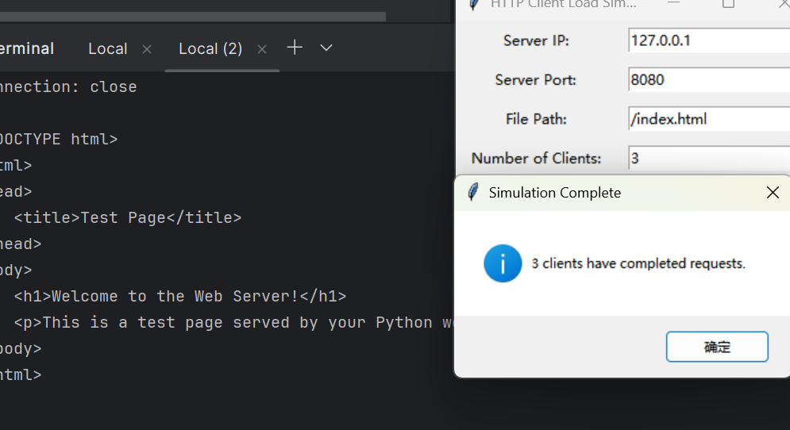
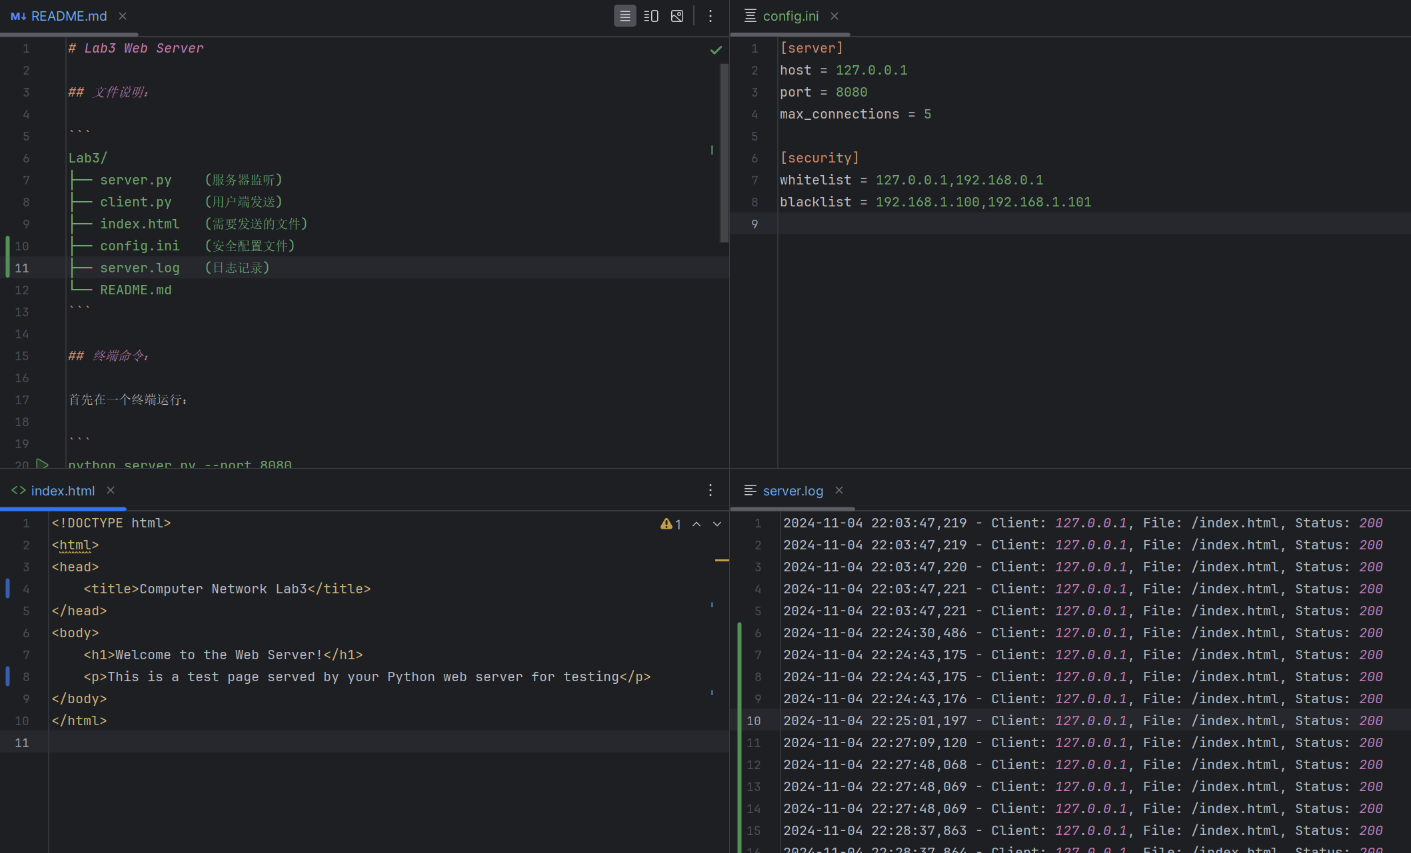
introduction
client
server
test
conclusion
Show the result
Using ICMP:
UI display
rate control
concurrent send
safety config, server log, README.md, etc.

Slide 16
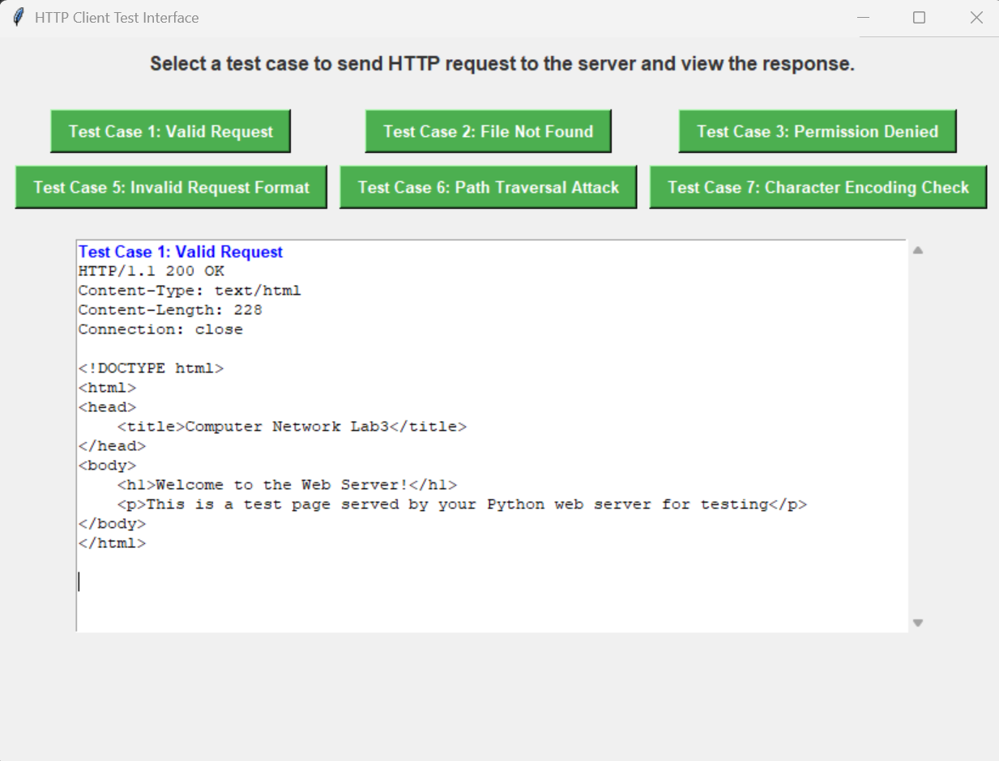
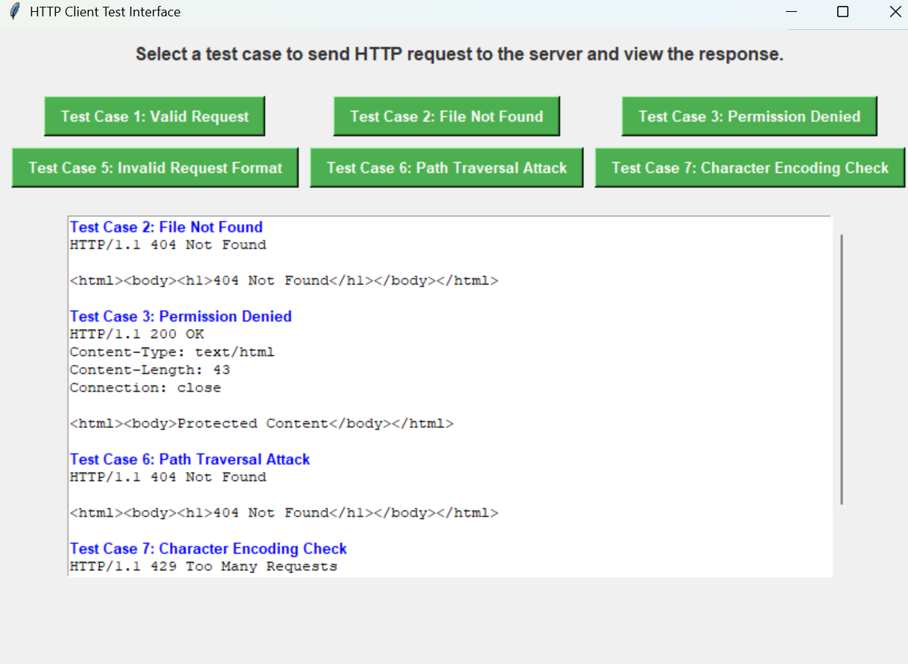
introduction
client
server
test
conclusion
Show the result
6 test types

Slide 17
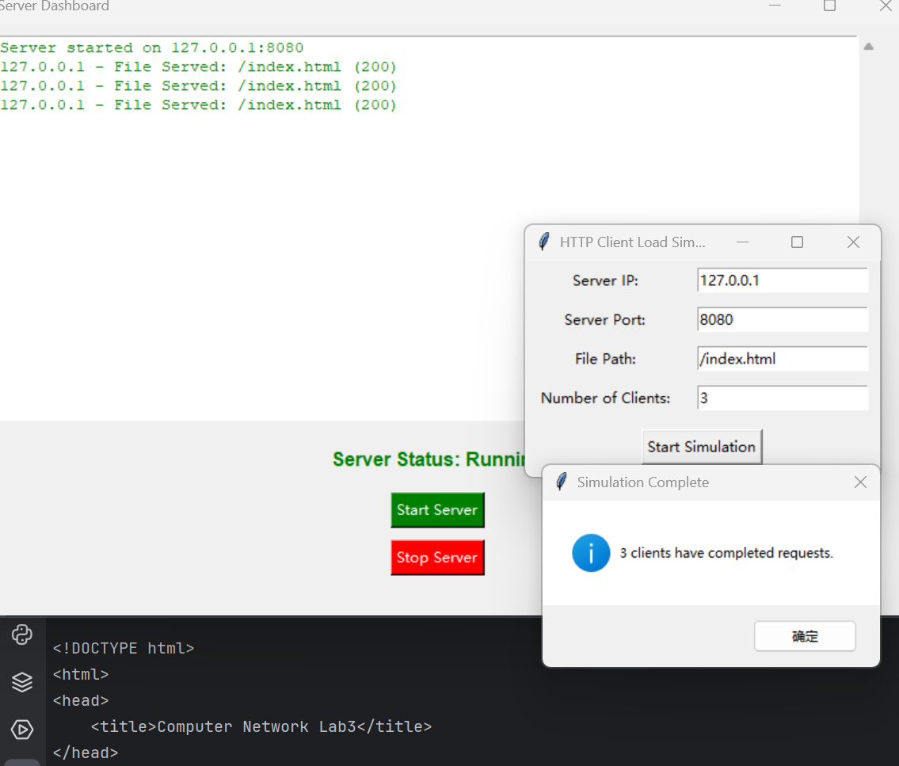
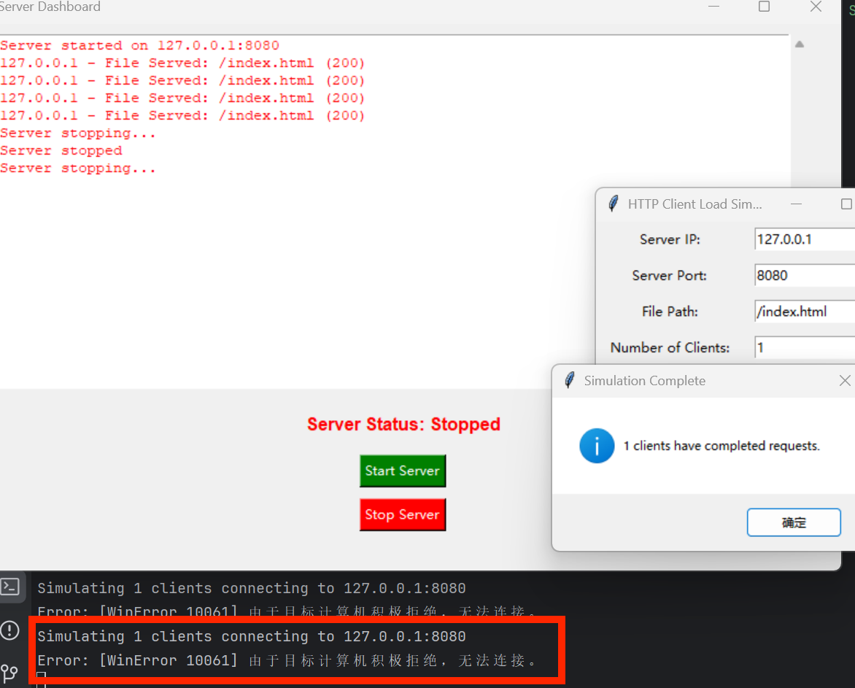
introduction
client
server
test
conclusion
Show the result
visualization

Slide 18
05
PART
Conclusion

Slide 19


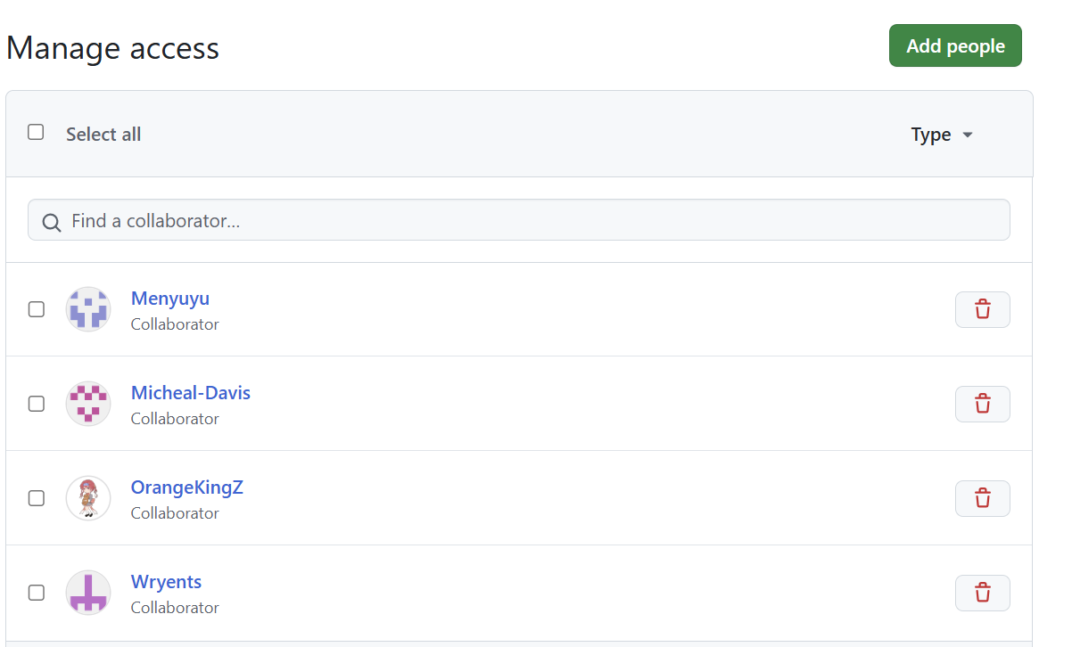
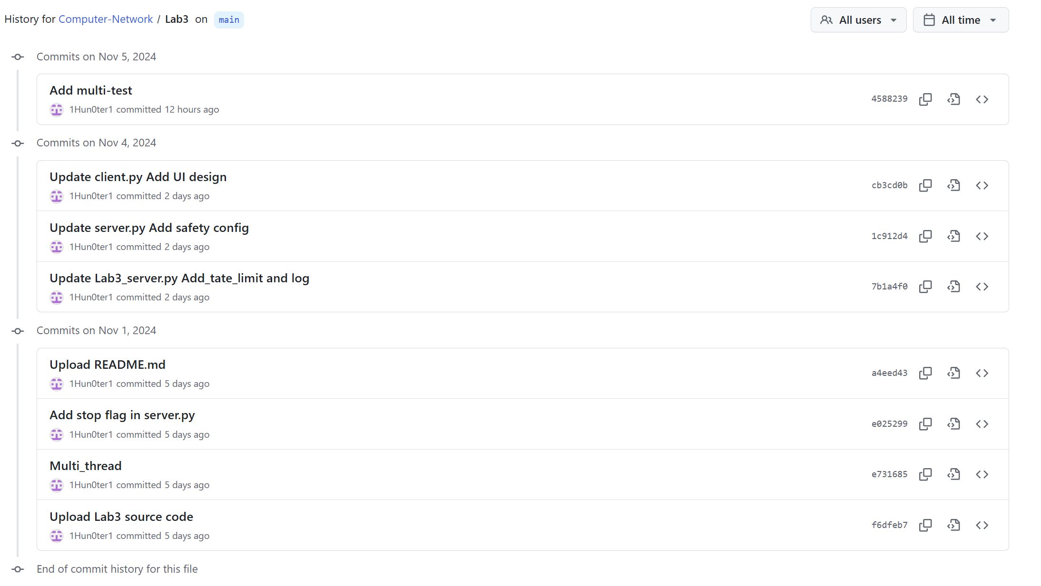
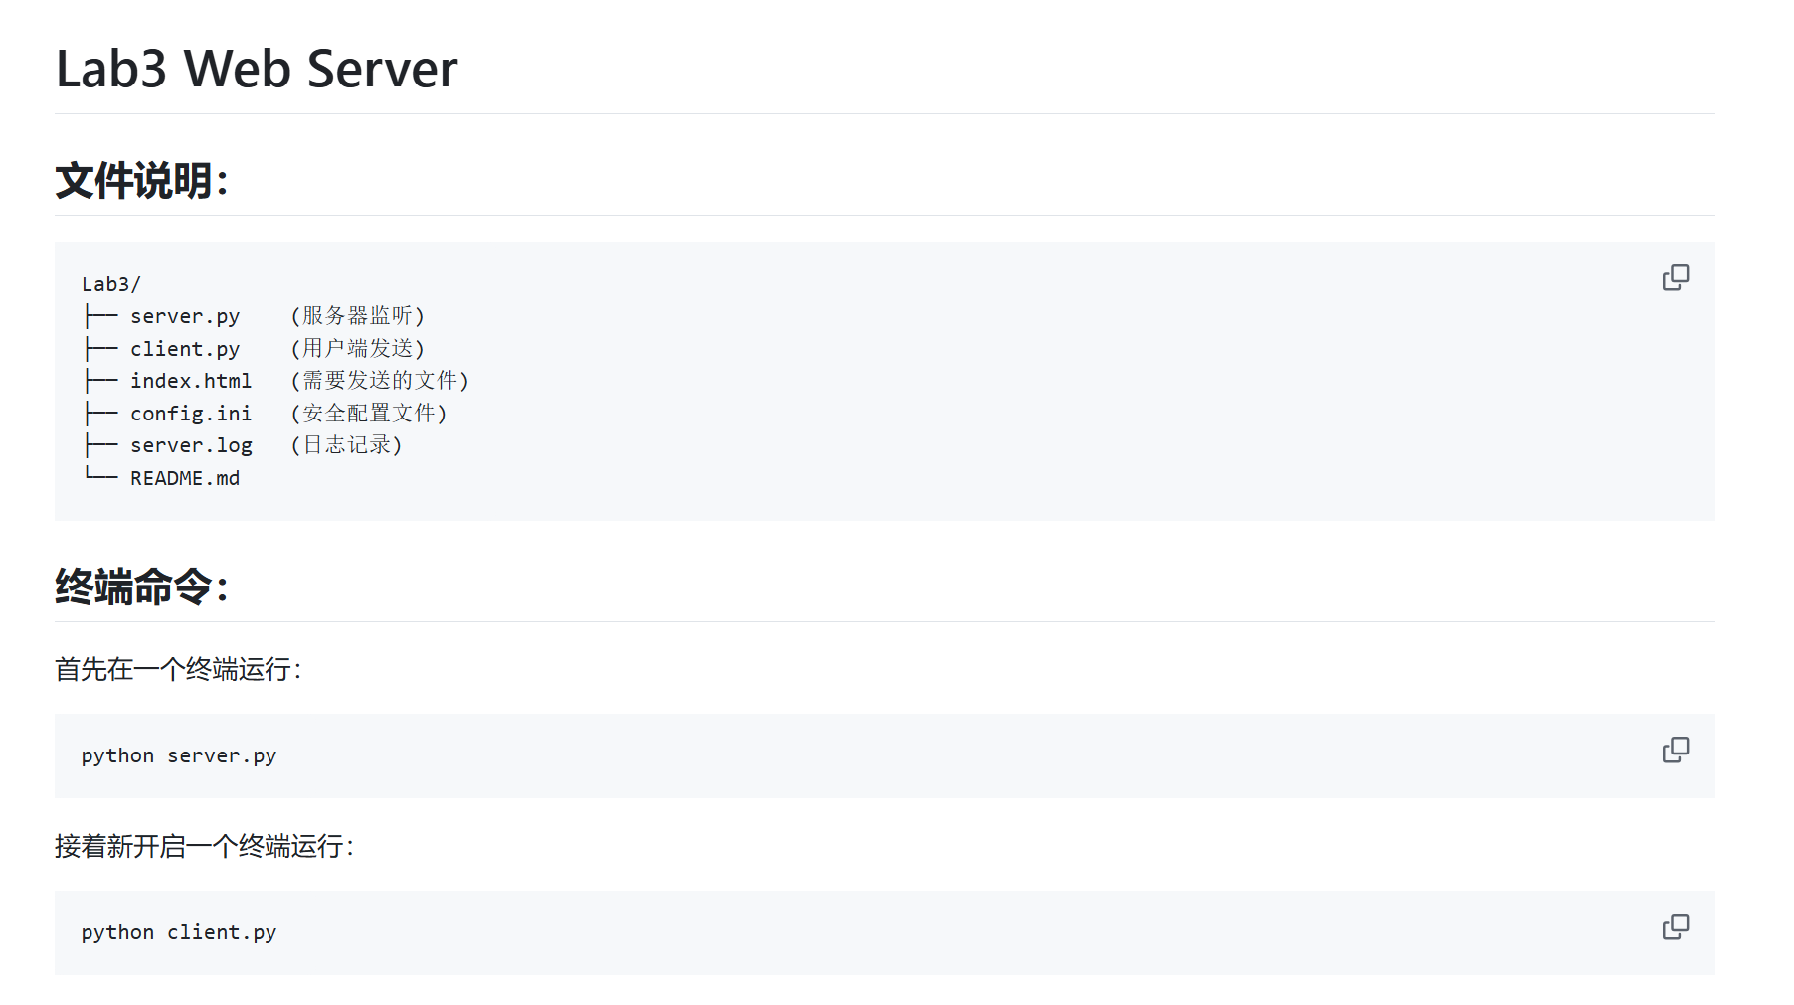
prepare
client
server
test
conclusion
Version control: Using Github
README.md
9 files
config.ini, server.log
8 histories
5 collaborators

Slide 20
prepare
client
server
test
conclusion
Summary of all functional implementations
Simulation of server & client
Multithreading
rate control
safety config design
UI design
log storage(.log)

Slide 21
Thank you!
Huang Hao, Zhou Yitong, Meng Yu, Chen Zijie, Wen Tianshu
2024.11.6

